Slide 1
Climate Policy and the European Green Deal
Dr Emma Shortis
European Union Centre of Excellence
RMIT University
emma.shortis@rmit.edu.au
@EmmaShortis

Slide 2
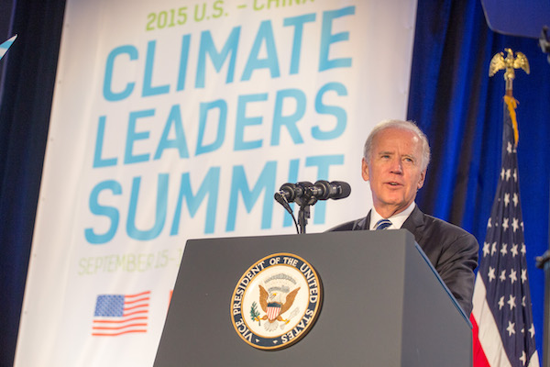
Global Developments
The Biden administration's 'Plan for a Clean Energy Revolution and Climate Justice':
100% clean energy economy and net-zero emissions no later than 2050.
The GND: “Biden believes the Green New Deal is a crucial framework for meeting the climate challenges we face. It powerfully captures two basic truths, which are at the core of his plan: (1) the United States urgently needs to embrace greater ambition on an epic scale to meet the scope of this challenge, and (2) our environment and our economy are completely and totally connected.”
"Biden will lead the world to address the climate emergency" and recommit the United States to the Paris Agreement

Slide 3
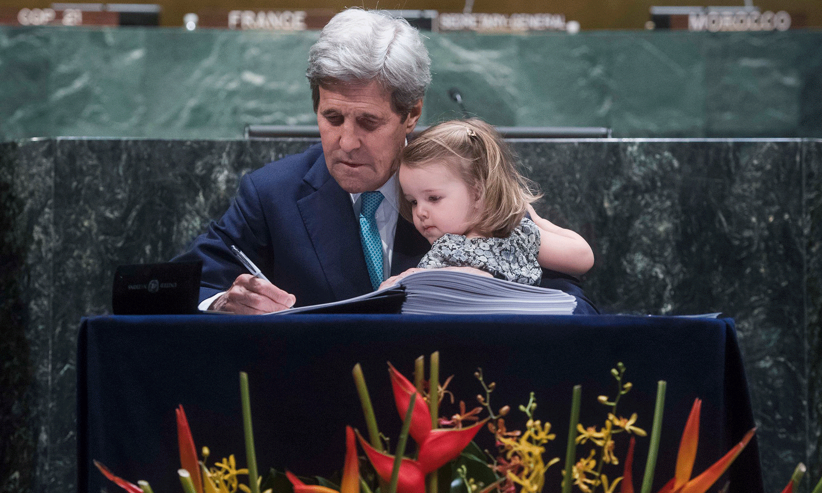
Global Leadership?
z

Slide 4
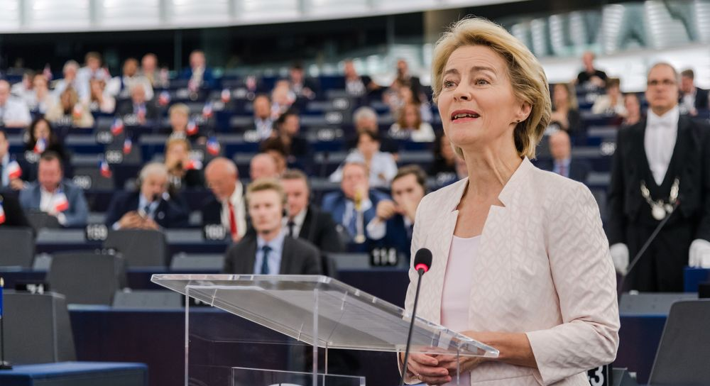
Global Leadership?
z

Slide 5
European Climate Policy
1990: European Community announces objective to stabilise emissions at 1990 levels by 2000, through energy conservation measures and a carbon tax.
1997: Kyoto Protocol. EU agrees to cut emissions eight per cent in the period 2008-2012. The targets are not equally distributed among member states.
2001: 21% renewable energy target
2005: European Union Emissions Trading Scheme (first and biggest in the world)
2009 – huge ambition at Copenhagen, undermined by the US
2015 – Paris Accords and the SDGs.

Slide 6
The European Green Deal
https://www.politico.eu/policy-guide/

Slide 7
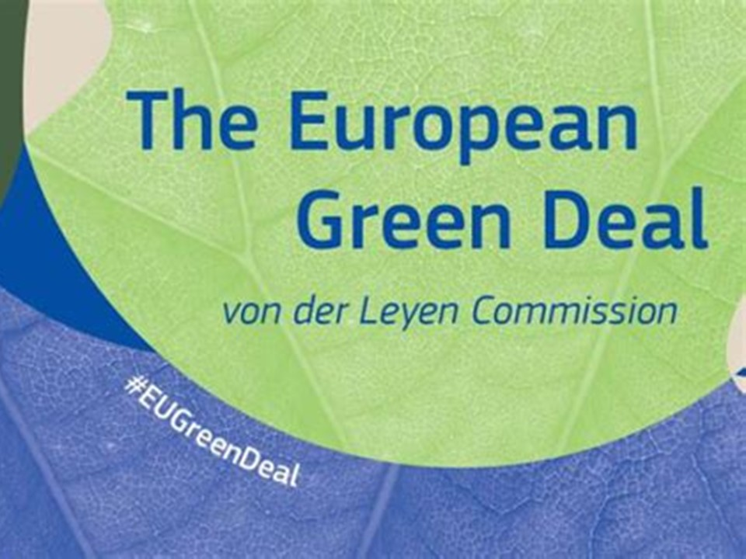
The European Green Deal
Refuses the economy/environment binary
'Moonshot': complete system overhaul
€1 trillion - €503 billion from EU, €114 billion from member states, and the rest from the private sector.
55 per cent emissions cut by 2030, and a ‘carbon-neutral continent’ by 2050
Integration of existing EU and Member State environmental policies
Circular economy—’Food to Fork’ strategy
Ecosystem biodiversity
A ‘Just Transition Fund’ to support coal-dependent Member States’ energy transition
Carbon Border Tax on importers

Slide 8
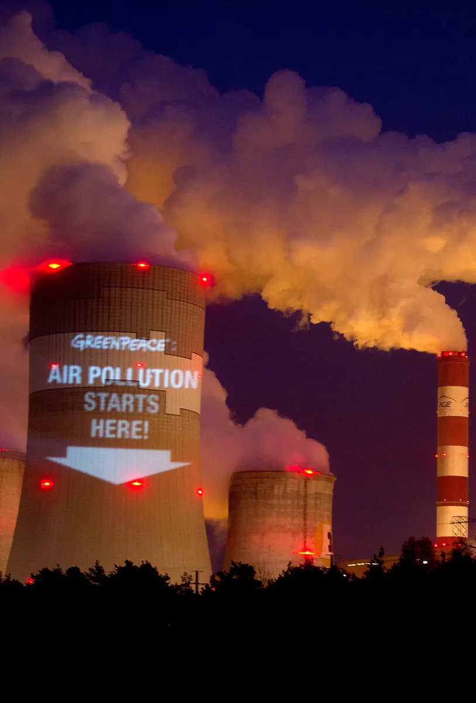
Critics of the EGD (I)
What are the costs?
The ‘trade-off’ approach has positioned climate action and growth against each other
This has also been seen in responses to coronavirus: ‘Europe should forget about the Green Deal now and focus on the coronavirus instead’
Is it fair?
Coal-dependent Member states are asking for greater concessions and adapted targets
MEPs have argued that advanced economies are already carrying their fair share of the climate burden

Slide 9
Critics of the EGD (II)
Does it go far enough?
ENGOs and climate activists are calling for at least 60 per cent by 2030, and carbon neutrality by 2040
Parliament’s environment committee supports the 2030 60 per cent target
Is this a ‘just transition’?
Critics have accused the EU of ‘greenwashing’ and offloading risk onto the public through financing for green investment
There are calls to end fossil fuel subsidies sooner—not later.

Slide 10
Significance
Bloomfield and Steward: EGD as a "turning point in the relationship between the traditionally separate policy areas of environmental protection and economic development. In broad terms it reoriented the European process of macroeconomic coordination from growth to sustainability."
Politico: “...one of the most consequential legislative efforts in the history of the European Union”
> massive shift for climate and sustainability politics and trajectory of Europe

Slide 11
